Slide 1

A. P. Shah Institute of Technology
International Conference on Recent Trends in Computer Engineering (ICRTCE-2019)
AI Chatbot for Regional Languages
/home/apsit/Desktop/iCASTE-2019/ICASTe-2018 PPT Template-Civ.ppt
ICRTME-2019
<number>
<number>
Notes:
<number>
<number>
<number>

Slide 2
Names of the Author &
Co-Authors
1)Ketan Makwana
2)Ganesh Kamath
3)Gaurav Hulmukh
ICRTME-2019
<number>
<number>
Notes:
<number>
<number>

Slide 3
Outline of Presentation
Abstract
Introduction
Literature Review
Problem Statement / Problem Definition
Proposed System
Implementation / Technologies Used
Result Discussion
Conclusion
ICRTME-2019
<number>
<number>
Notes:
<number>
<number>

Slide 4
ABSTRACT
AI chatbot aims to make a effective conversation between both human and machine.
The machine has been embedded knowledge to identify the sentences and choosing the right response for the question.
The system has the ability to perform payments such as electricity payment.Initially,the user has to enter the important credentials manually for first time.It also gives reminder of the pending bills to be paid.
Front-end of the system is developed using Dialogflow API and the system is trained with the help of Tensorflow
Tokenization of the sentence is performed using TextBlob library.
ICRTME-2019
<number>
ICRTME-2019
Notes:
<number>
<number>

Slide 5
INTRODUCTION
A chatbot is often described as one of the most advanced and promising expressions of interaction between humans and Machines.
However, from a technological point of view, a chatbot only represents the natural evolution of a Questio Answering system leveraging Natural Language Processing(NLP).
Formulating responses to questions in natural language is one of the most typical Examples of Natural Language Processing applied in various enterprises end-use applications.
The purpose of the chatbot was to develop friendly interaction with the human. It can be considered as one of the best assistant of the human as the machine has the ability to perform the task as human do and many companies like facebook,amazon,Twitter are investing a lot of money for developing an effective chatbot.
ICRTME-2019
<number>
<number>
Notes:
<number>
<number>

Slide 6
LITERATURE REVIEW
In 1950,Alan Turing published a famous paper titled ‘Computer Machinery And Intelligence.
Nowadays Alexa,Google Assistance is used for effective communication with user
Google Duplex uses the concept of Deep Learning.
ICRTME-2019
<number>
<number>
Notes:
<number>
<number>
<number>

Slide 7
PROBLEM STATEMENT
To build and effective chatbot that have the ability to responsd to the user Queries in no time and perform the necessary transactions such as bill Payment,ect.
ICRTME-2019
<number>
<number>
Notes:
<number>
<number>
<number>

Slide 8
PROPOSED SYSTEM
The system will be developed in Python by using Natural Language Processing(NLP).
Also,it can perform transactions.But if it is implemented for the first time,the user has to enter all the credentials manually(i.e credit/debit card,CVV,aadhar card,PAN ).
It will maintain a database which will store all the credentials and when another transactions is to be done,then user need not require to retype again the information.It will automatically fill all the requirements.
ICRTME-2019
<number>
<number>
Notes:
<number>
<number>
<number>

Slide 9
IMPLEMENTATION / TECHNOLOGIES USED
Chatbot will be implemented by using Tensorflow which is an open source library for training models
On the other hand Tokenization will be done using TextBlob.
The front end of the system will be developed using Dialogflow API where the system will receive input from the user in the form of text/voice and the response will be generated immediately.
The system will maintain a database in the JSON format
ICRTME-2019
<number>
<number>
Notes:
<number>
<number>
<number>

Slide 10
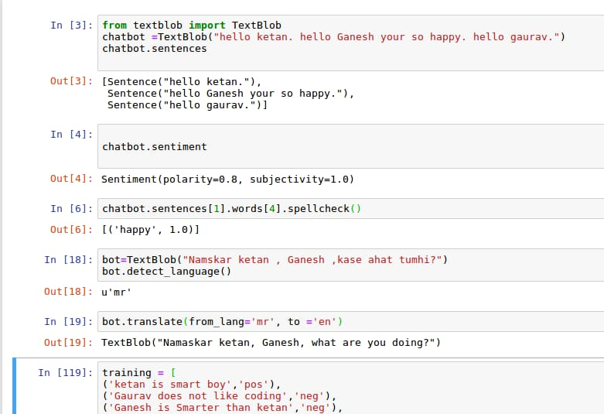
RESULT ANALYSIS
ICRTME-2019
<number>
<number>
Notes:
<number>
<number>
<number>

Slide 11
CONCLUSION
Thus,chatbot aims to reduced the workload of the user to solve the queries in no time and by using the datasets and improvised training methods,it can maintain its sustainability for a longer time.Our system will have the ability to adapt to the new enviroment
ICRTME-2019
<number>
<number>
Notes:
<number>
<number>
<number>

Slide 12
QUESTIONS ?
ICRTME-2019
<number>
<number>
Notes:
<number>
<number>

Slide 13
Thank you!
ICRTME-2019
<number>
<number>
Notes:
<number>
<number>

